Slide 2
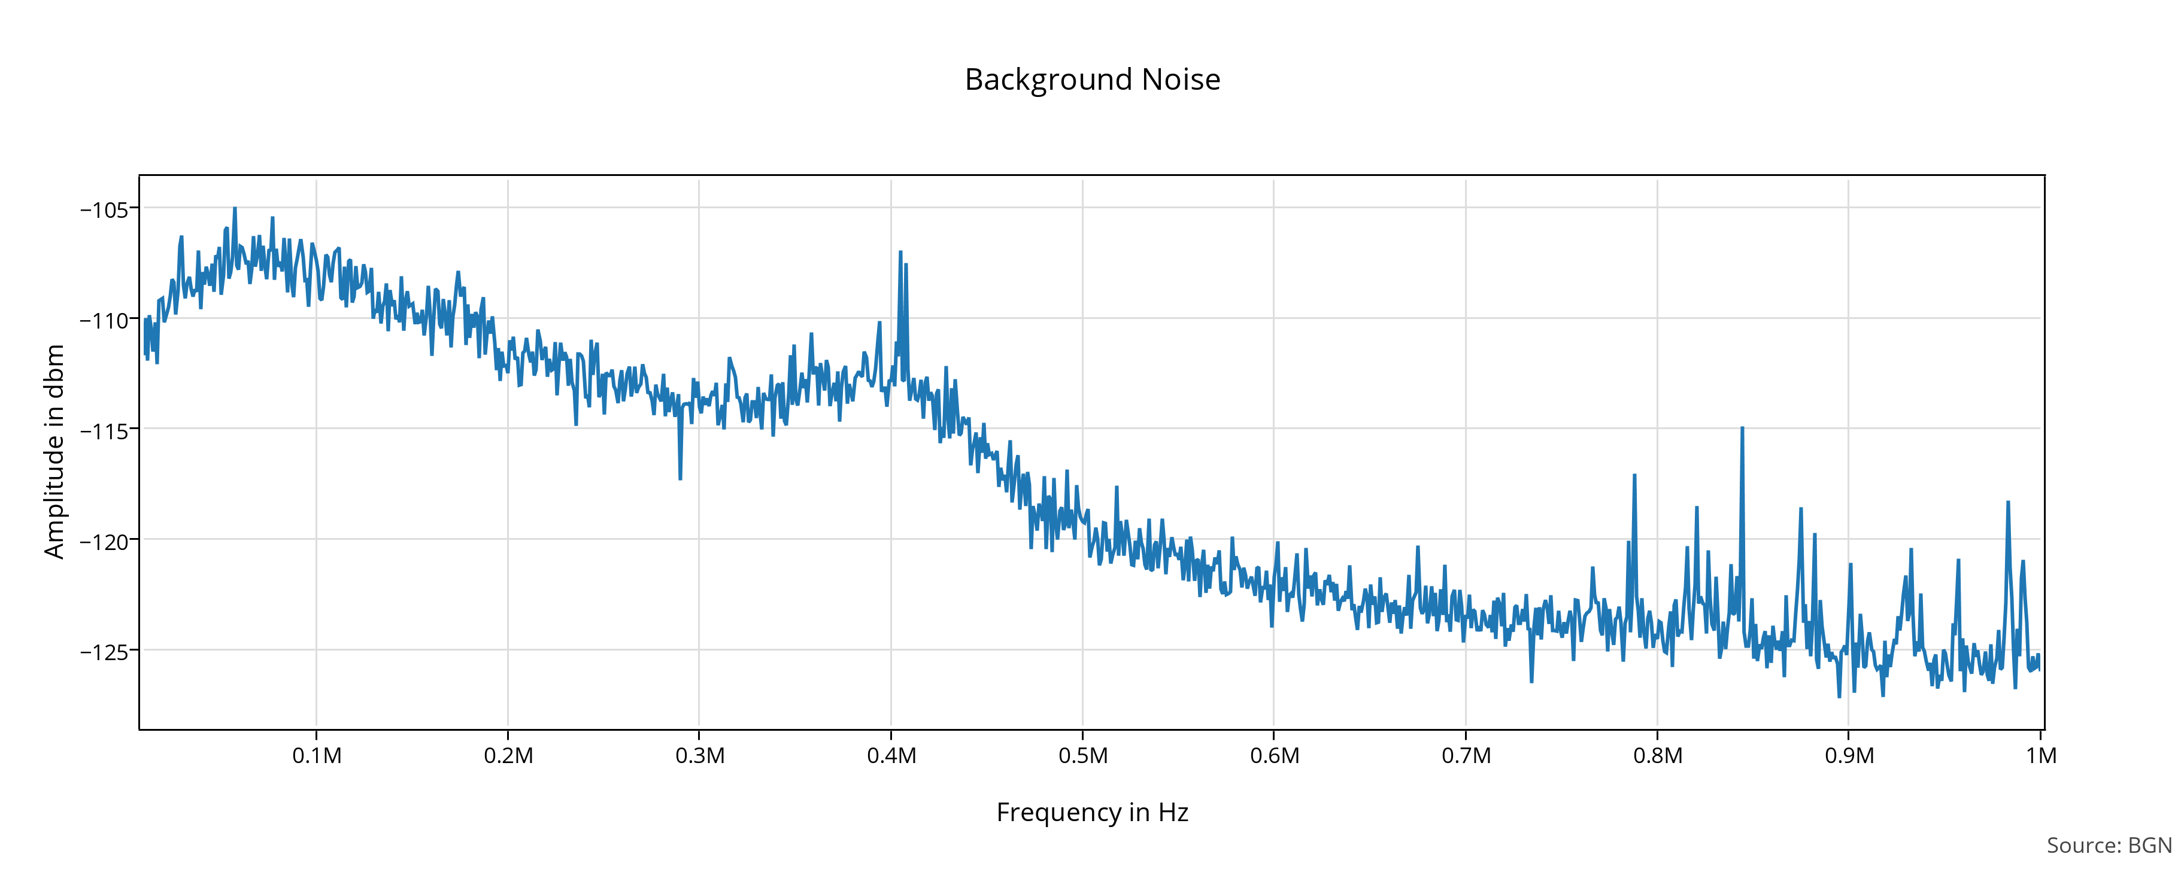
Background Noise

Slide 3
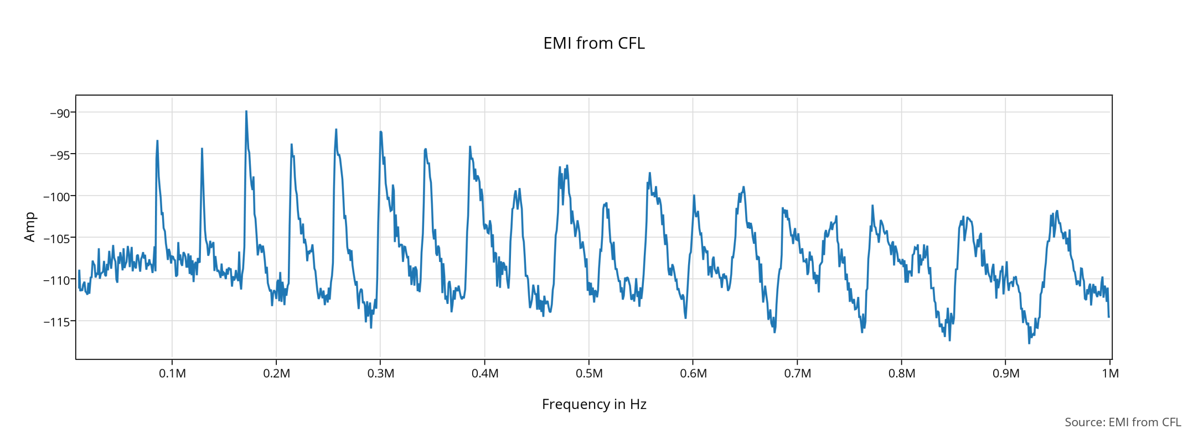
CFL Noise

Slide 4
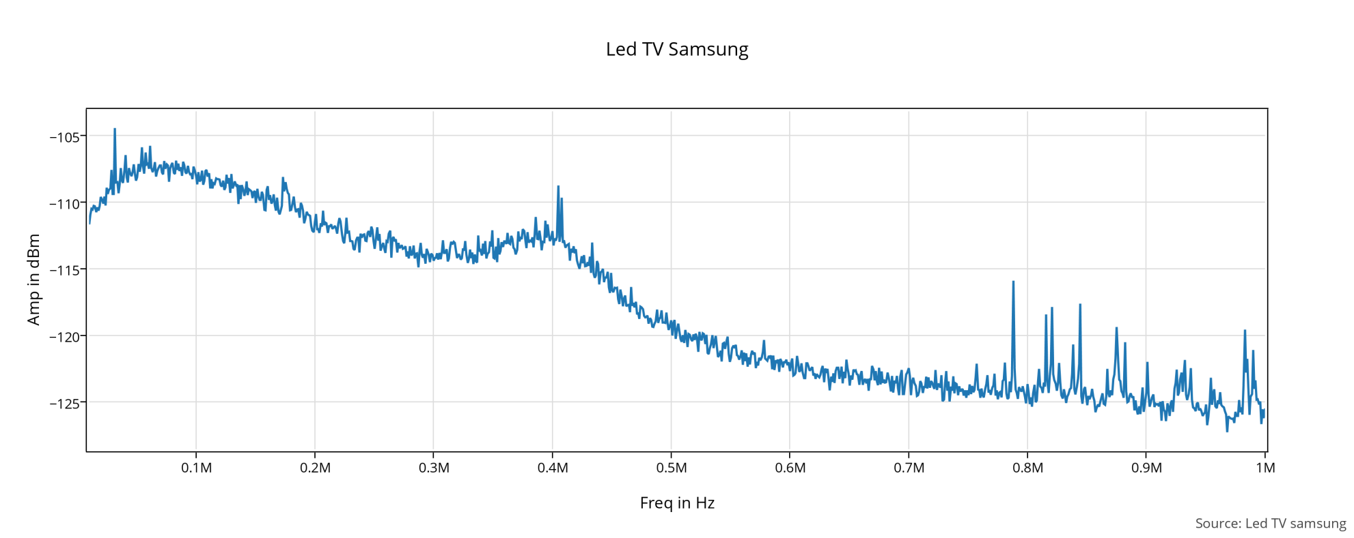
LED TV

Slide 5
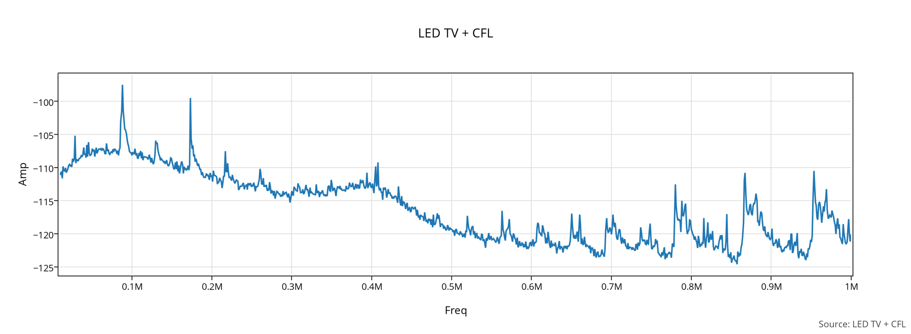
LED TV + CFL

Slide 6
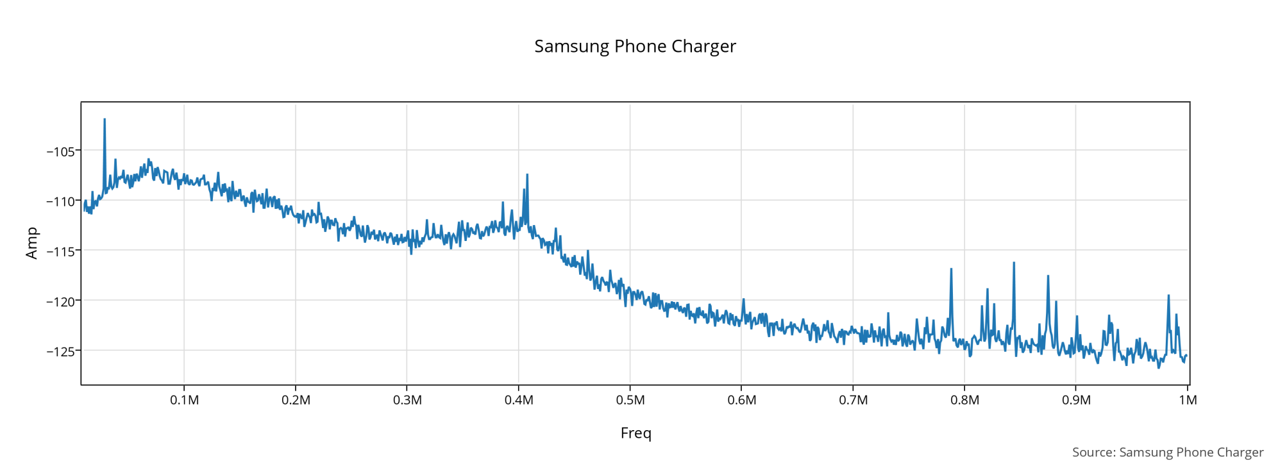
Samsung Phone Charger

Slide 7
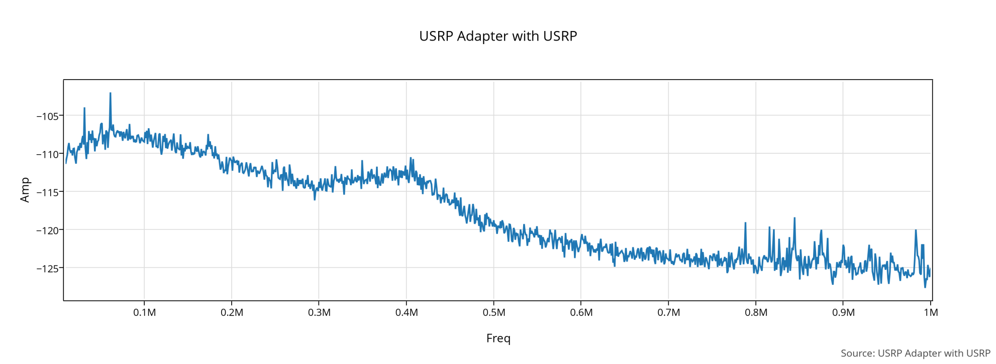
USRP Adapter

Slide 8
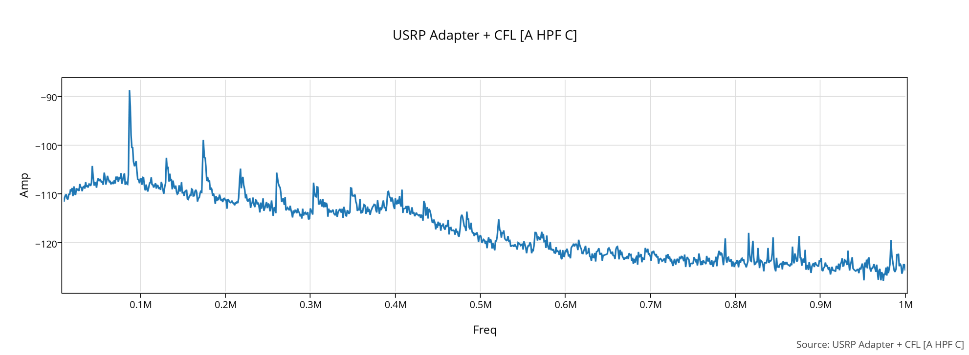
USRP Adapter + CFL

Slide 9
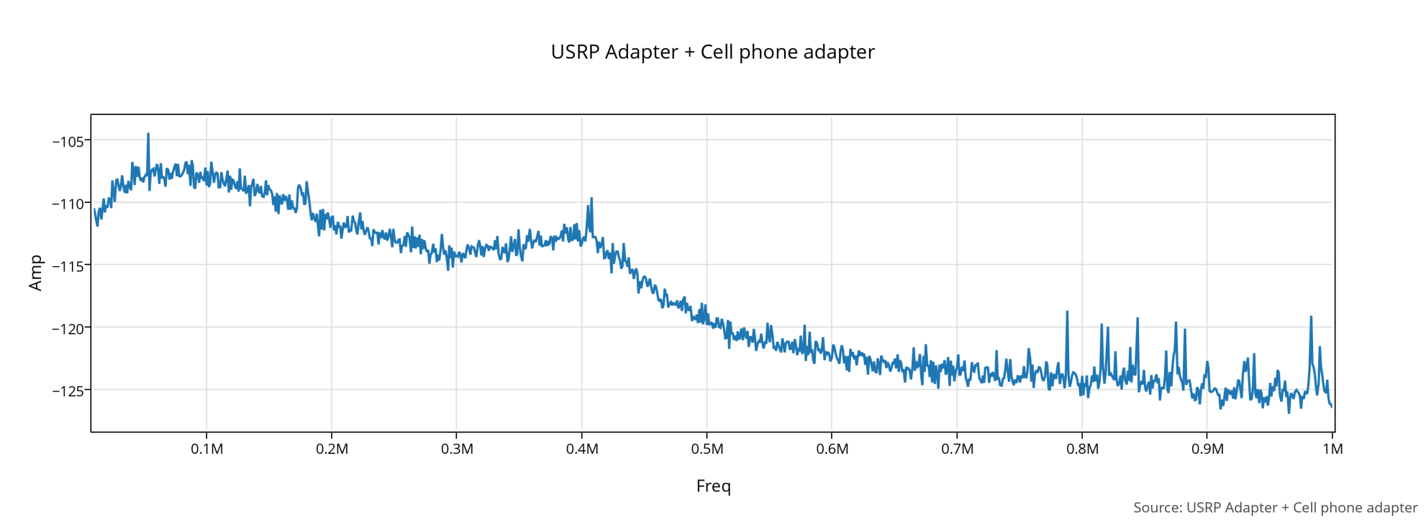
USRP Adapter + Cell Phone charger

Slide 10
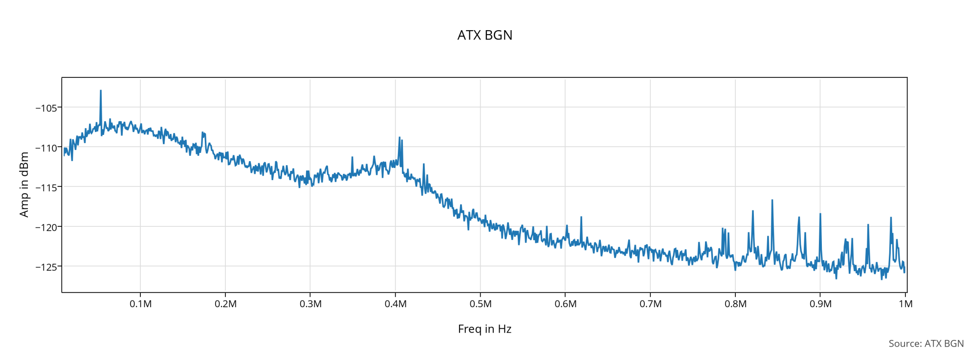
Background Noise ATX PS

Slide 11
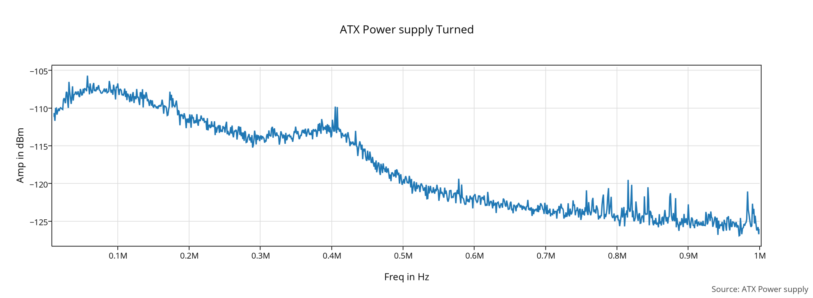
ATX Power Supply

Slide 12
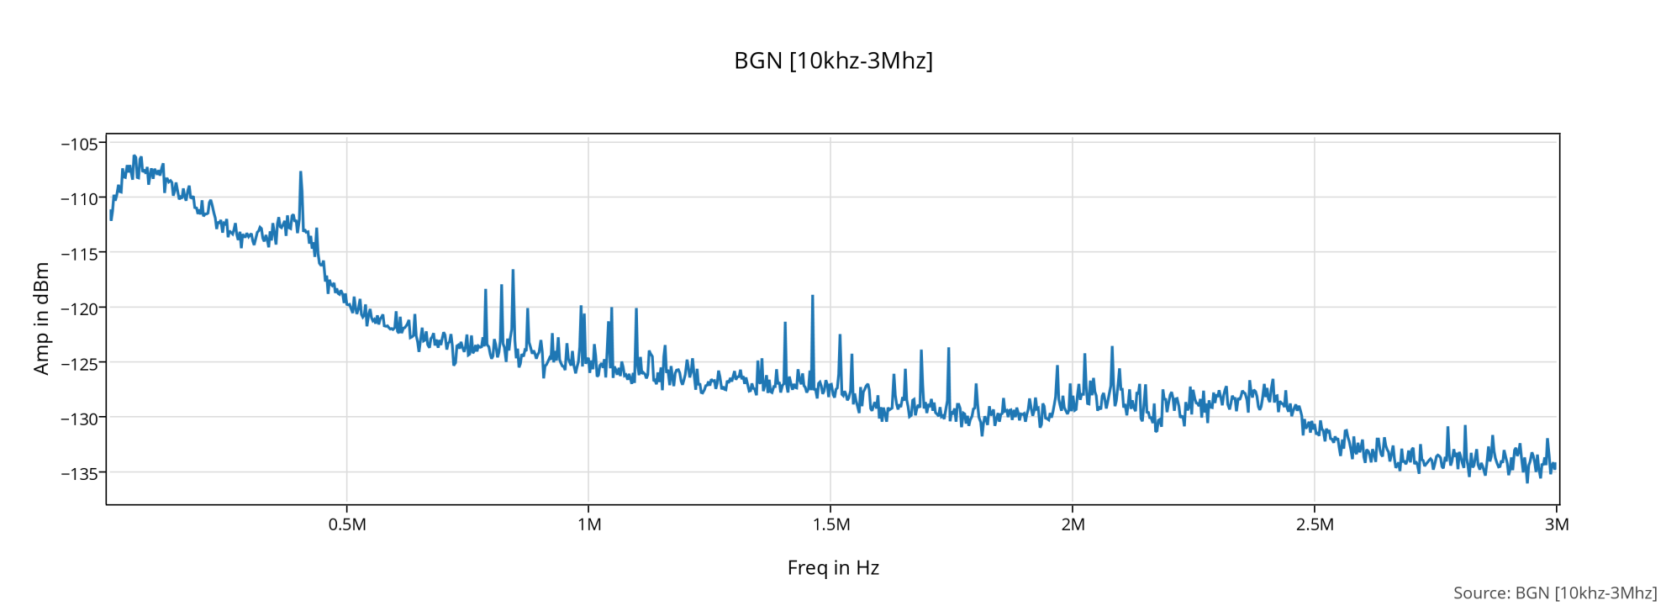
BGN 10Khz-3Mhz

Slide 13
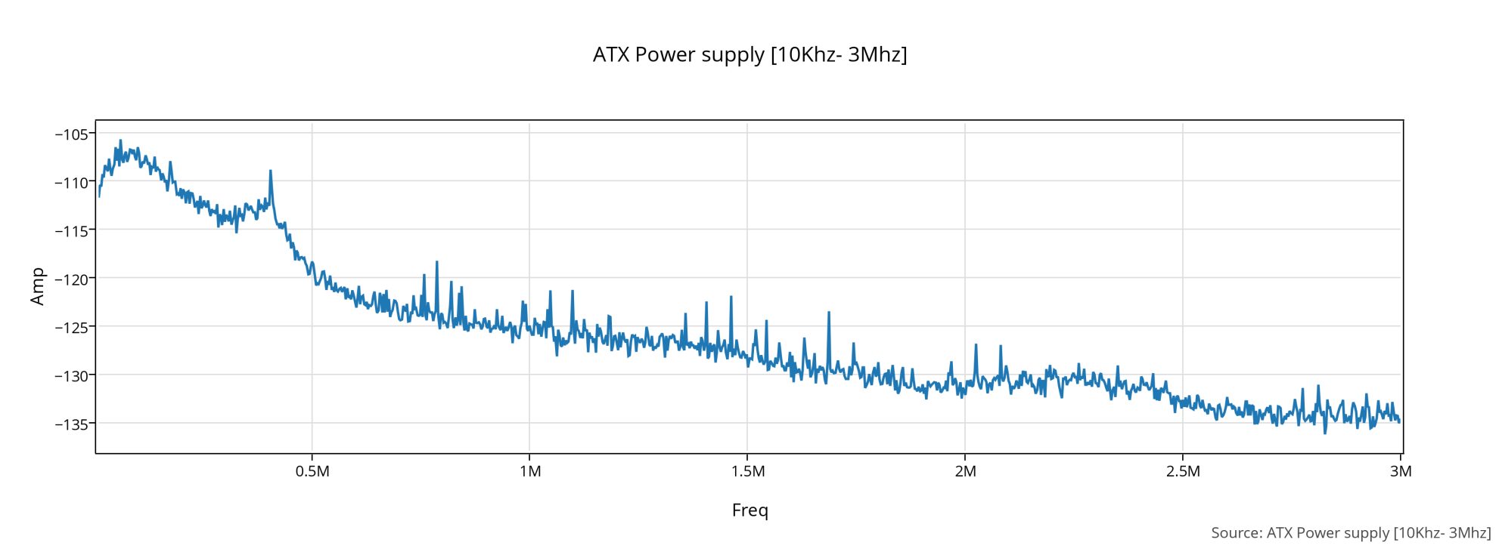
ATX PS 10Khz-3Mhz

Slide 14
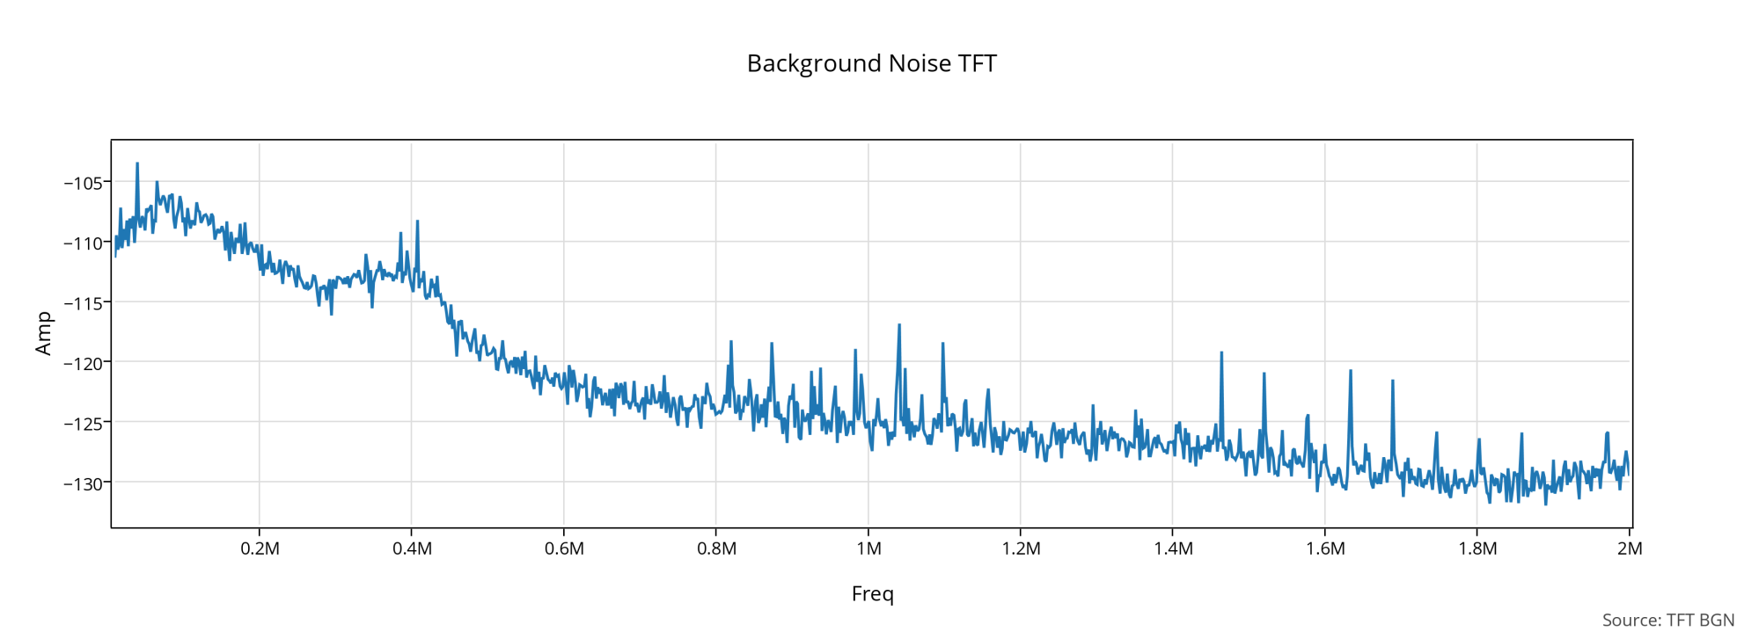
BGN TFT

Slide 15
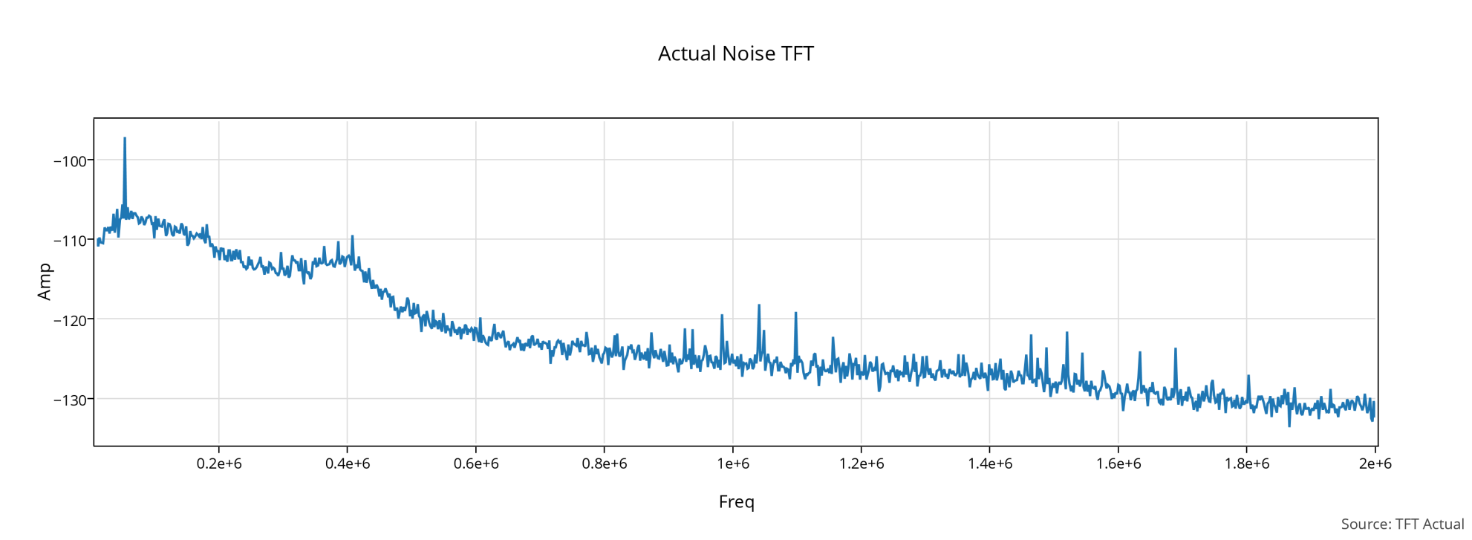
Actual TFT

Slide 16
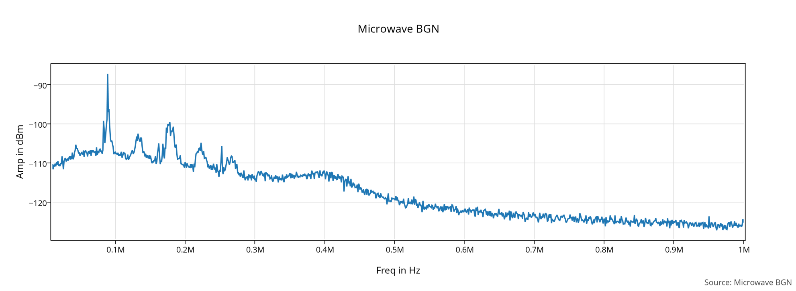
Microwave BGN

Slide 17
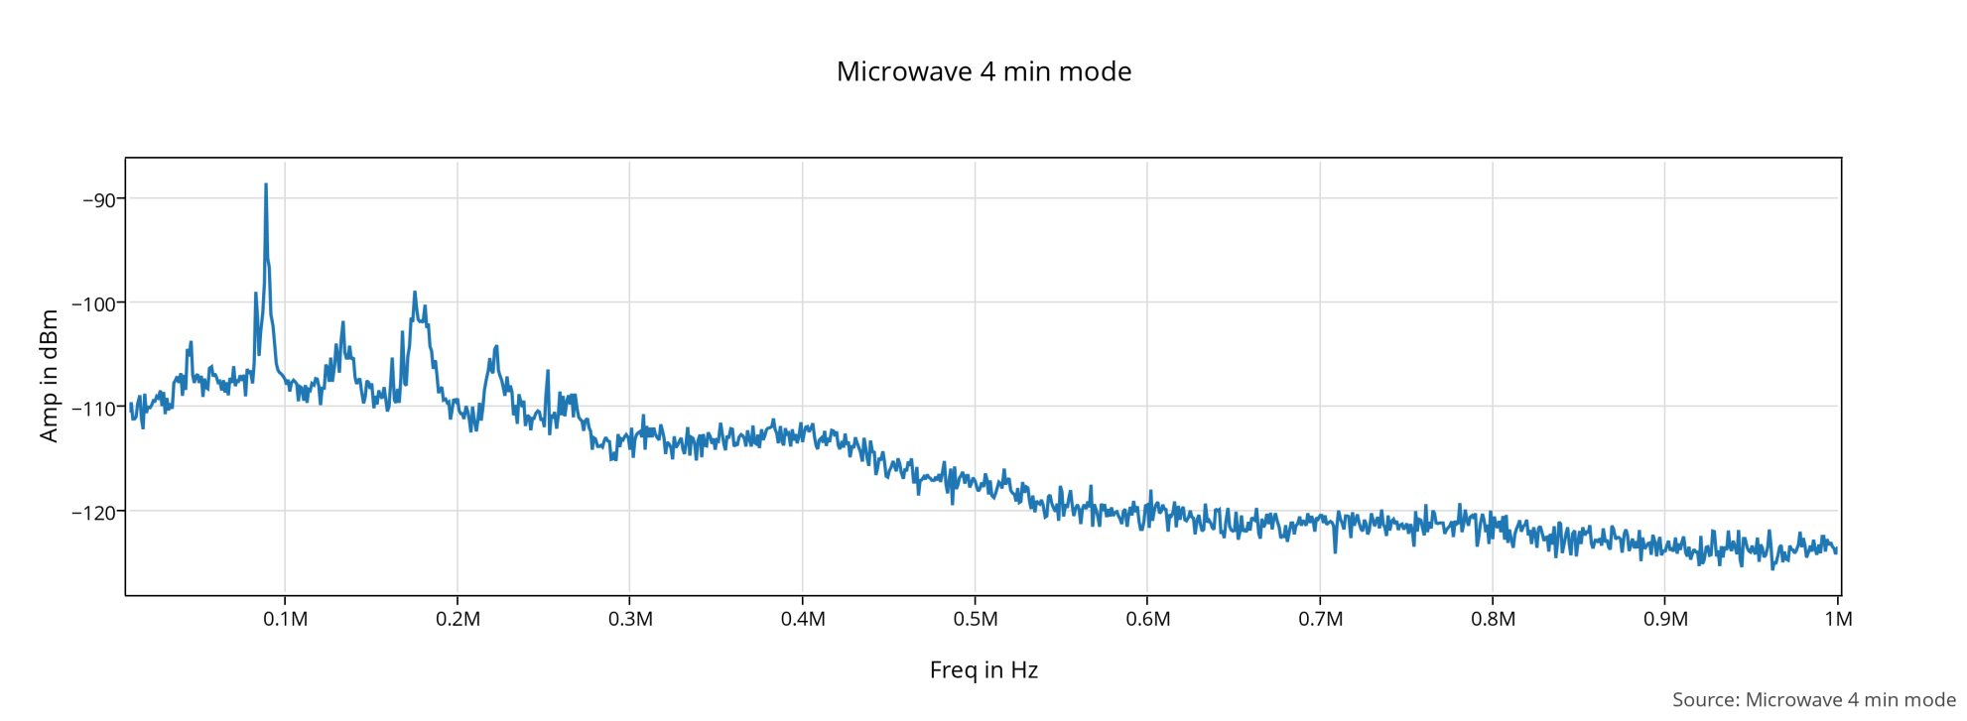
Microwave 4 min mode

Slide 18
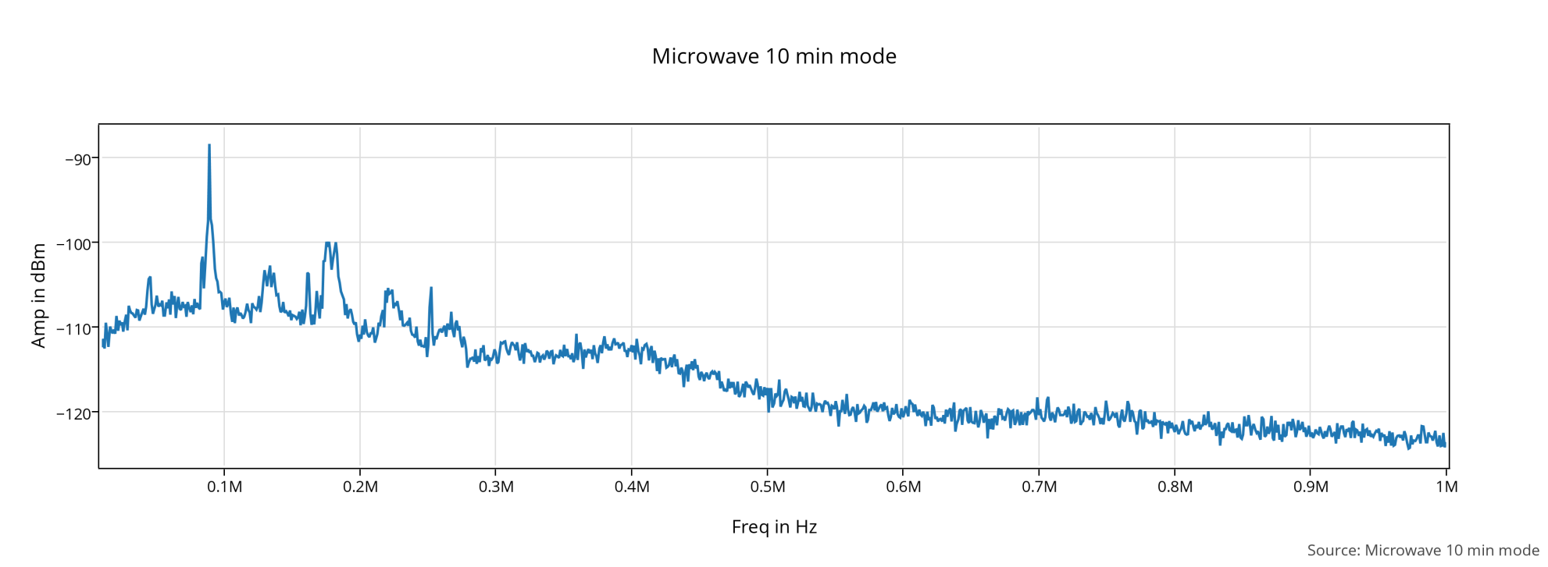
Microwave 10 min mode

Slide 19
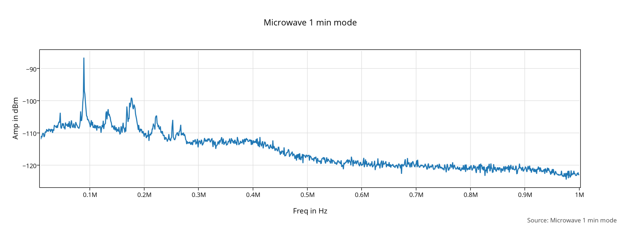
Microwave 1 min mode

Slide 20
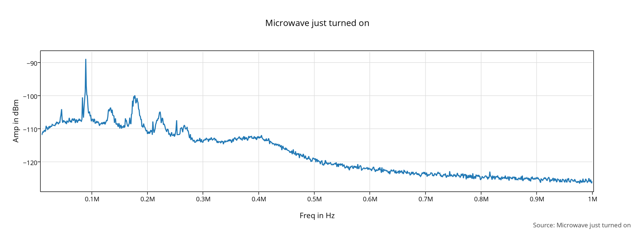
Microwave just turned on

Slide 21
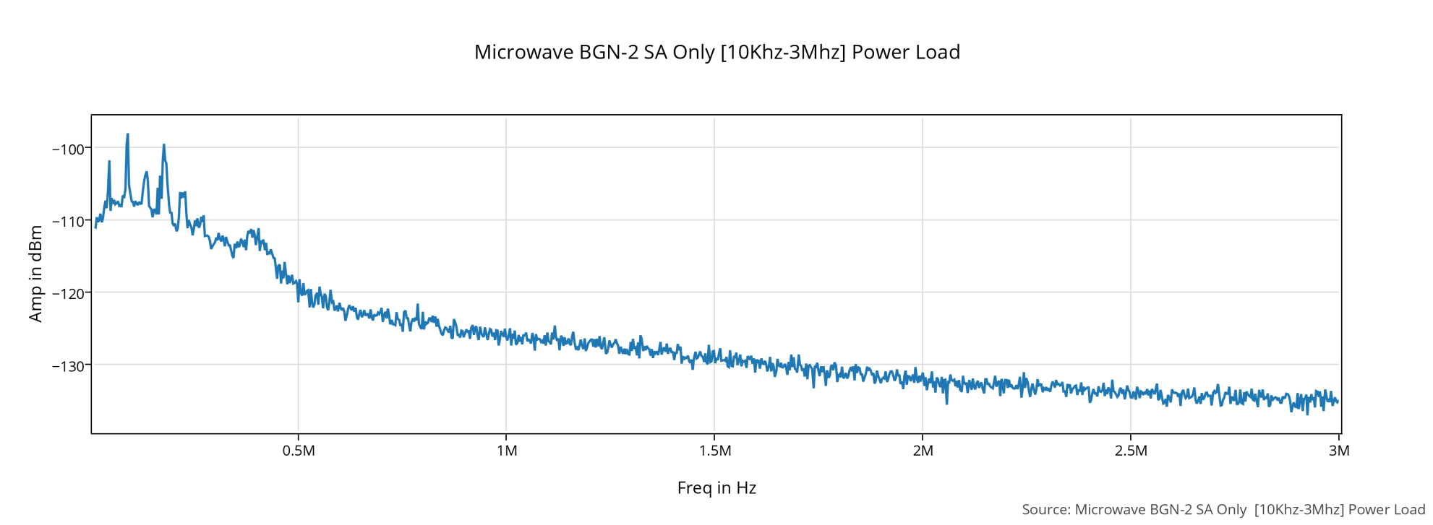
Microwave BGN [10Khz-3Mhz]

Slide 22
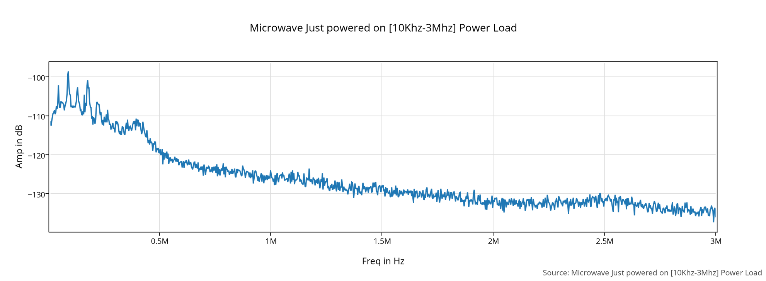
Microwave just powered on [10Khz-3Mhz]

Slide 23
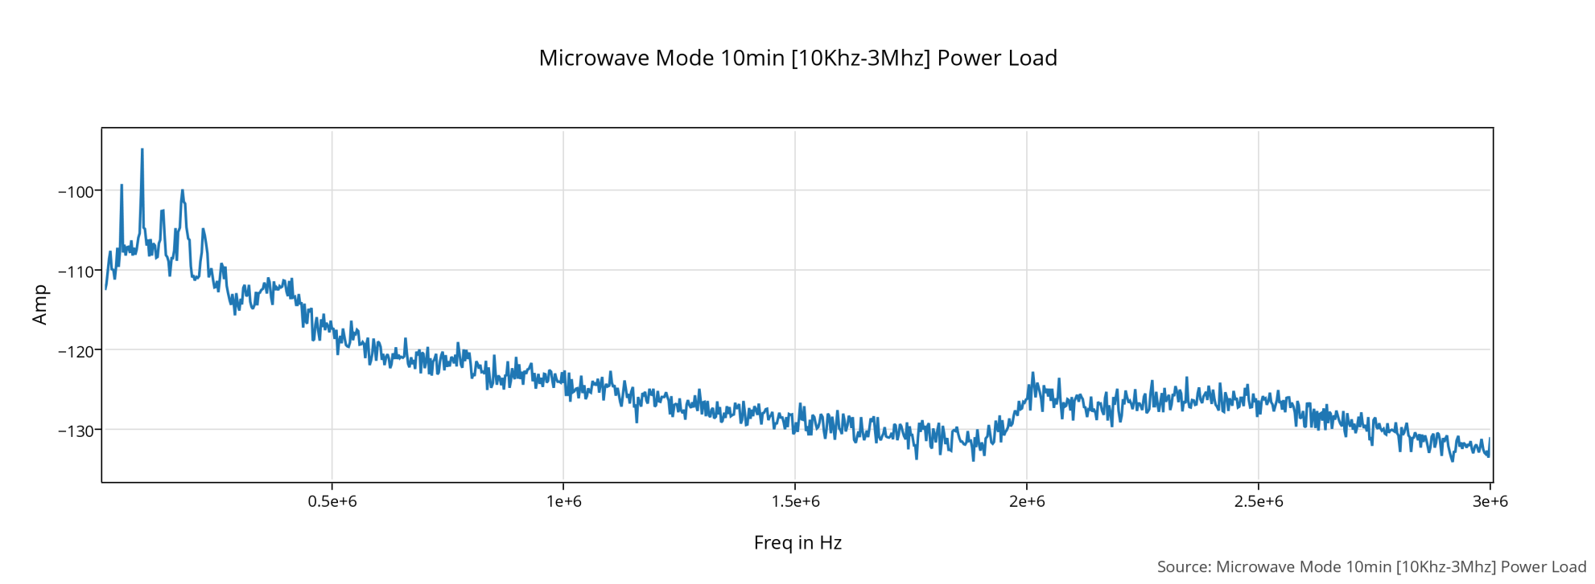
Microwave Mode 10 min[10Khz-3Mhz]

Slide 24
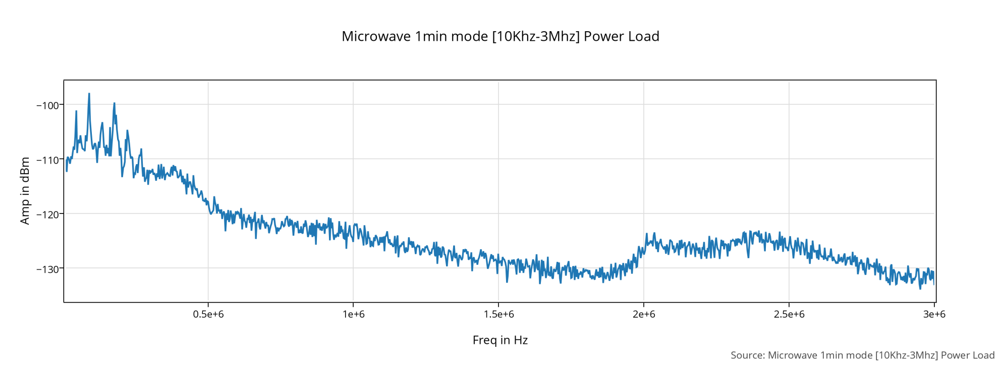
Microwave Mode 1 min[10Khz-3Mhz]

Slide 25
Microwave BGN SA on [10Khz-3Mhz]

